Slide 1
LOGO Design Presentation
Presented by Shrijan Uniyal

Slide 2
Contents of this Presentation
WINDOWS | 1st
H&M | 2nd
FEDEX | 3rd
BURGER KING | 4th
FERRARI | 5th
Thanks! | END

Slide 3

WINDOWS
The colors in the Windows logo—blue, green, yellow, and red—are part of a distinctive design known as the "Windows flag”
Blue represents stability and reliability.
Green represents vitality and balance.
Yellow represents innovation and energy.
Red represents passion and creativity.

Slide 4

More Information
“A multicolored windowpane “with four squares of different colors (blue, green, yellow, and red) arranged in a 2x2 grid. The design creates a perspective effect, giving the appearance of a three-dimensional window. This iconic and familiar logo represents the various applications and possibilities within the Windows operating system.
Together, these colors symbolize the diversity of applications, features, and possibilities offered by the Windows operating system, creating a visually appealing and recognizable brand emblem.

Slide 5
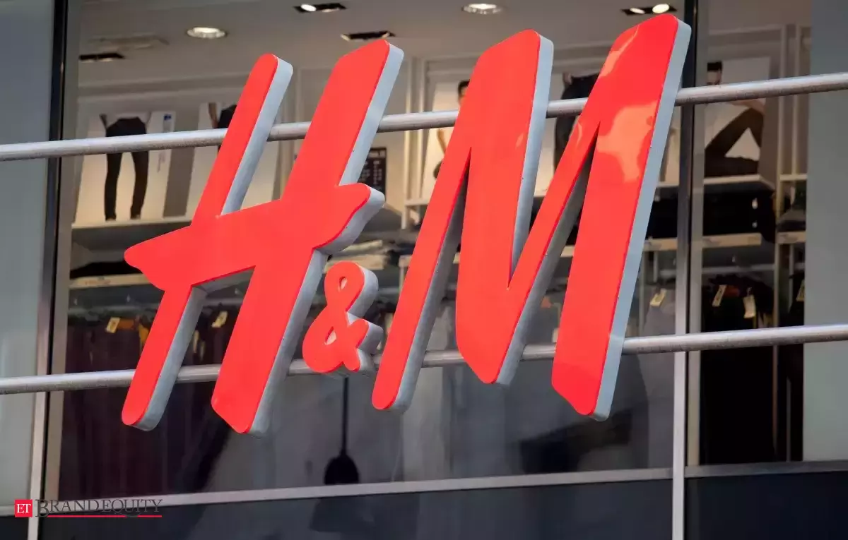
H&M
The “H&M” initial is simple and clean, featuring the brand itself .The letters are often white or red , creating a minimalist and timeless design. The simplicity of the logo reflects H&M's focus on fashion trends and accessibility. It's a versatile and recognizable emblem that aligns with the brand's commitment to offering affordable and stylish clothing.

Slide 6
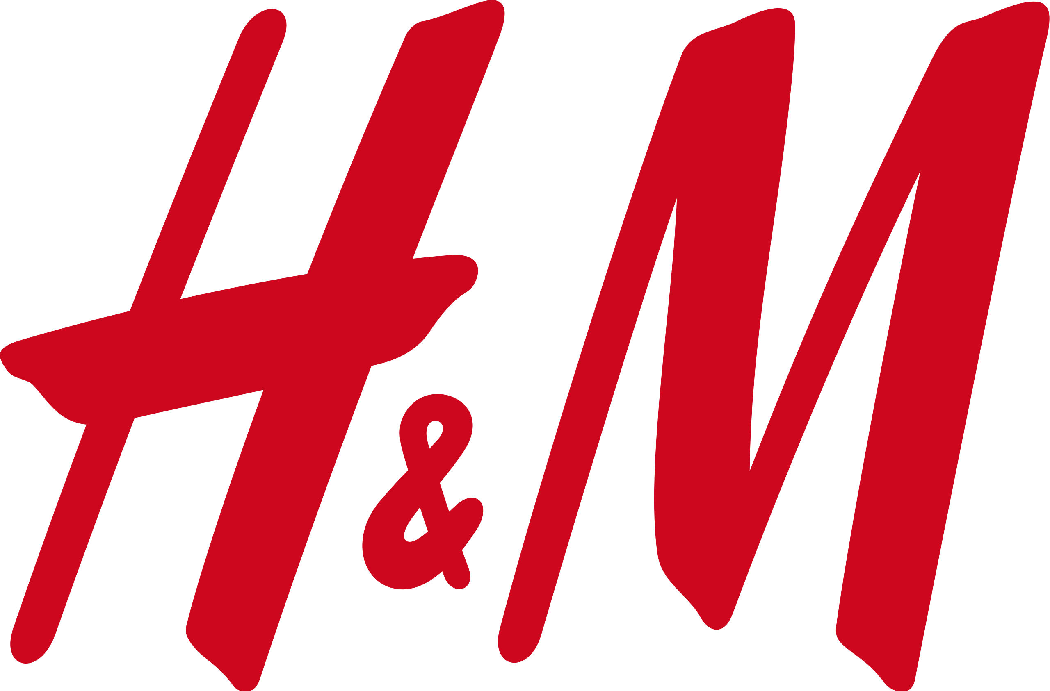
COLOURS RELEVANCE
Neutral color palette convey a sense of elegance and timelessness, reflecting H&M's approach to fashion. By using a clean and straightforward design with neutral colors, the logo remains versatile and adaptable to various contexts, contributing to the brand's overall aesthetic of accessible and trendy fashion.

Slide 7
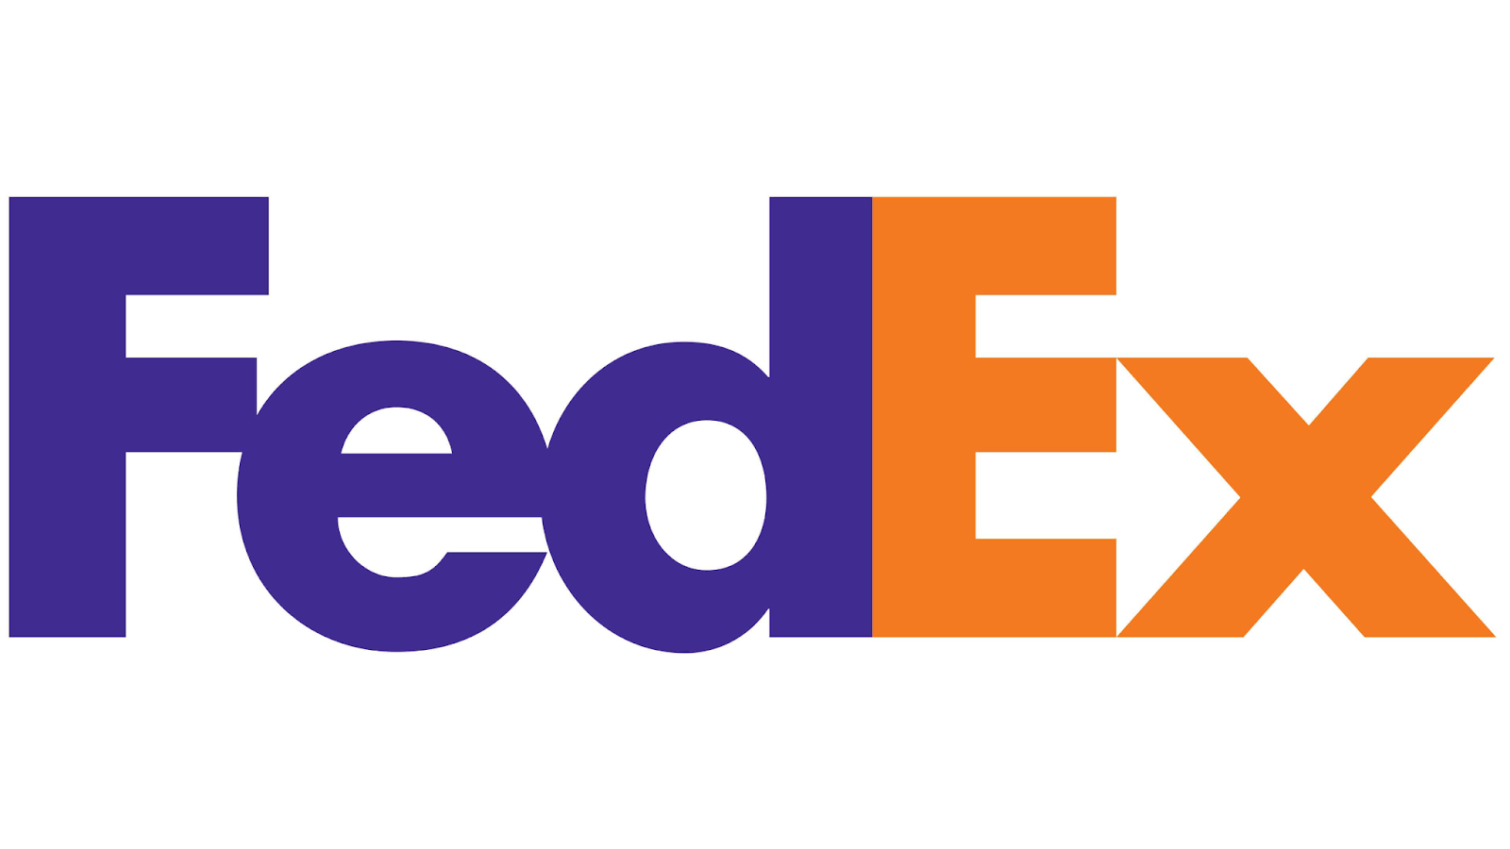
FEDEX
The FedEx logo is known for its clever use of negative space. The logo features the company's name, "FedEx," in a bold and purple uppercase font. What makes it distinctive is the hidden arrow formed by the negative space between the letters 'E' and 'x.' This arrow symbolizes the company's precision, speed, and forward movement, aligning with its reputation for efficient and reliable delivery services.
The FedEx logo primarily uses a combination of purple and white. Purple is associated with qualities like creativity, luxury, and sophistication. In the context of FedEx, it adds a touch of professionalism and innovation to the brand. The white background enhances visibility and readability, creating a clean and modern aesthetic. The strategic use of color in the logo contributes to conveying a sense of trustworthiness and efficiency in the company's delivery services.

Slide 8
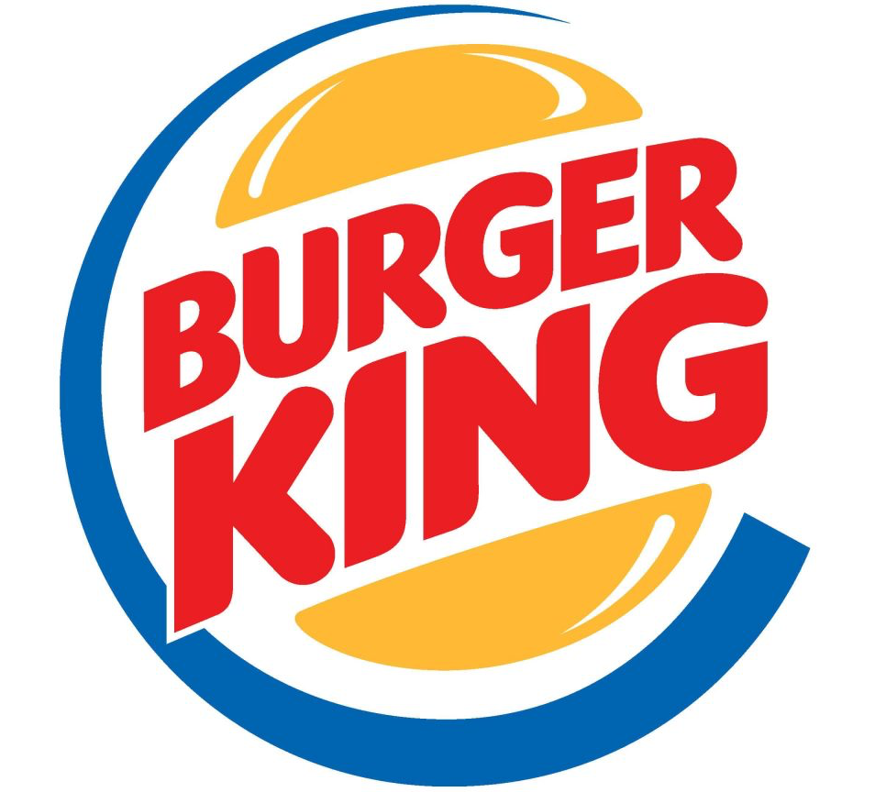
BURGER KING
A stylized, retro-inspired bun that encircles the brand's name, "Burger King." The bun design is often in warm, golden-brown colors, and the lettering is bold and capitalized. The overall design creates a sense of classic, nostalgic fast-food imagery, while the choice of colors aligns with the appetizing and indulgent nature of the products offered by Burger King.
The colors warm golden-brown tones are reminiscent of freshly baked buns and evoke a sense of warmth and appetizing appeal. The warm color palette contributes to the logo's overall inviting and nostalgic feel.

Slide 9
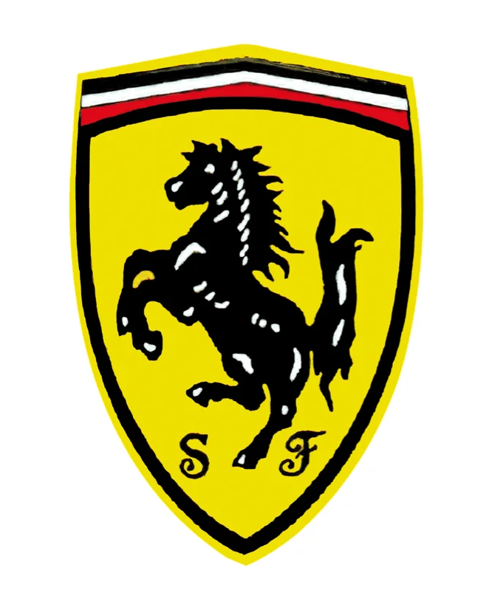
FERRARI
Black symbolizes elegance, power, and sophistication. In the context of the Ferrari logo, it adds a sense of luxury and exclusivity, reflecting the brand's high-performance and premium identity.
Yellow, this vibrant color is associated with energy, speed, and enthusiasm. In the Ferrari logo, the yellow background not only enhances visibility but also contributes to the dynamic and passionate image of the brand, aligning with the excitement and performance associated with Ferrari's sports cars.

Slide 10
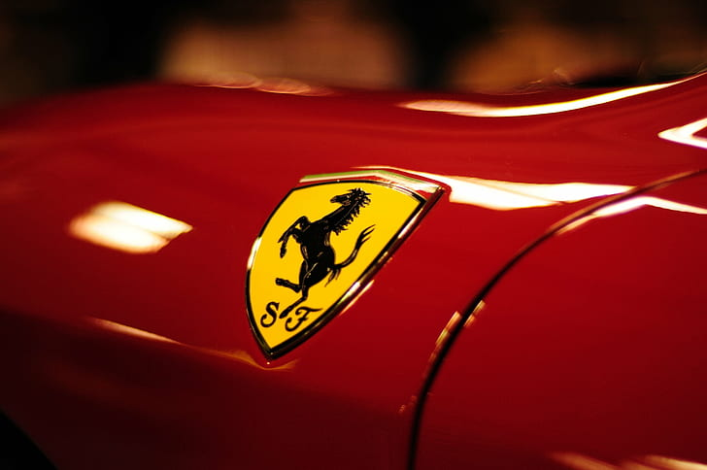
More Information
The Ferrari logo is a distinctive and iconic design. It features a black prancing horse, known as "Cavallino Rampante" in Italian, against a yellow background. The horse is positioned inside a black shield with the word "Ferrari" written above it. The logo symbolizes power, speed, and luxury, reflecting the brand's identity as a high-performance sports car manufacturer. The yellow background adds a touch of vibrancy and complements the overall aesthetic, creating a symbol that is synonymous with excellence and passion in the automotive world.The Ferrari logo predominantly features the colors black and yellow. The black prancing horse, positioned against a yellow background within a black shield, creates a striking and iconic contrast.

Slide 11
Thanks!
SHRIJAN UNIYAL
Btech CSE (AIML)
SAP ID - 500107378

